Slide 1
10.01 Enlightenment, Revolution and Nationalism

Slide 2
Conceptual Understandings:
Enduring Understanding(s): NYS Key Ideas 10.2: ENLIGHTENMENT, REVOLUTION, AND NATIONALISM: The Enlightenment called into question traditional beliefs and inspired widespread political, economic, and social change. This intellectual movement was used to challenge political authorities in Europe and colonial rule in the Americas. These ideals inspired political and social movements. (Standards: 2, 3, 5; Themes: MOV, TCC, GEO, SOC, GOV, CIV) | Essential Question: How do turning points change history? Supporting Questions: 10.2a: According to the Enlightenment thinkers, how should a government rule its people? 10.2b: How did the Enlightenment affect 18th century social reform movements and Enlightened Despots? 10.2c: Was the French Revolution successful? 10.2d: What impact did the French Revolution have on world history?
Knowledge (NYS Conceptual Understandings): Students will know... | Skills (based on the NYS Content Specifications): Students will be able to…
10.2a Enlightenment thinkers developed political philosophies based on natural laws, which included the concepts of social contract, consent of the governed, and the rights of citizens. | Students will examine at least three Enlightenment thinkers, including John Locke, Baron de Montesquieu, and Jean-Jacques Rousseau, and key ideas from their written works.
10.2b Individuals used Enlightenment ideals to challenge traditional beliefs and secure people’s rights in reform movements, such as women’s rights and abolition; some leaders may be considered enlightened despots. | Students will explore the influence of Enlightenment ideals on issues of gender and abolition by examining the ideas of individuals such as Mary Wollstonecraft and William Wilberforce.
 | Students will examine enlightened despots including Catherine the Great

Slide 3
Conceptual Understandings:
Enduring Understanding(s): NYS Key Ideas 10.2: ENLIGHTENMENT, REVOLUTION, AND NATIONALISM: The Enlightenment called into question traditional beliefs and inspired widespread political, economic, and social change. This intellectual movement was used to challenge political authorities in Europe and colonial rule in the Americas. These ideals inspired political and social movements. (Standards: 2, 3, 5; Themes: MOV, TCC, GEO, SOC, GOV, CIV) | Essential Question: How do turning points change history? Supporting Questions: 10.2a: According to the Enlightenment thinkers, how should a government rule its people? 10.2b: How did the Enlightenment affect 18th century social reform movements and Enlightened Despots? 10.2c: Was the French Revolution successful? 10.2d: What impact did the French Revolution have on world history?
Knowledge (NYS Conceptual Understandings): Students will know... | Skills (based on the NYS Content Specifications): Students will be able to…
10.2a Enlightenment thinkers developed political philosophies based on natural laws, which included the concepts of social contract, consent of the governed, and the rights of citizens. | Students will examine at least three Enlightenment thinkers, including John Locke, Baron de Montesquieu, and Jean-Jacques Rousseau, and key ideas from their written works.
10.2b Individuals used Enlightenment ideals to challenge traditional beliefs and secure people’s rights in reform movements, such as women’s rights and abolition; some leaders may be considered enlightened despots. | Students will explore the influence of Enlightenment ideals on issues of gender and abolition by examining the ideas of individuals such as Mary Wollstonecraft and William Wilberforce.
 | Students will examine enlightened despots including Catherine the Great

Slide 4
Unit Essential Questions:
How did new ideas spark change and conflict in the late 18th and throughout the 19th centuries?
How do turning points change history?

Slide 5
Unit Description
The Enlightenment called into question traditional beliefs and inspired widespread political, economic, and social change. This intellectual movement was used to challenge political authorities in Europe and colonial rule in the Americas. These ideals inspired political and social movements.

Slide 6
Unit Activities and Assignments
VOCABULARY OPENER
CHROLOLOGICAL THINKING AND GRAPHIC CONTEXT – Absolute Monarchs
CONTEXTUALIZE AND CONNECT CAUSE AND EFFECT – EXPLAIN the historical circumstances that led to Absolute Monarchs in Europe in a CLAIM PARAGRAPH
MASTERING THE GRADE 10 GLOBAL HISTORY CURRICULUM - Chapter 6 -pgs. 56 - 79
CLOSE READ ACTIVITY (Mary Wollstonecraft)
Castle Learning 10.02
CONCEPT MAPS
The Enlightenment
French Revolution
Haitain Revolution
South American Independence Movements
Mexican War for Independence
Unification of Germany
Unification of Italy

Slide 7
BOOK PAGES
Enlightenment – 56-64
French Revolution – 64-65
Latin American Revolution 65-67
Unification of Italy – 67-68
Unification of Germany 68-70
Study Cards/Review 71-79

Slide 8
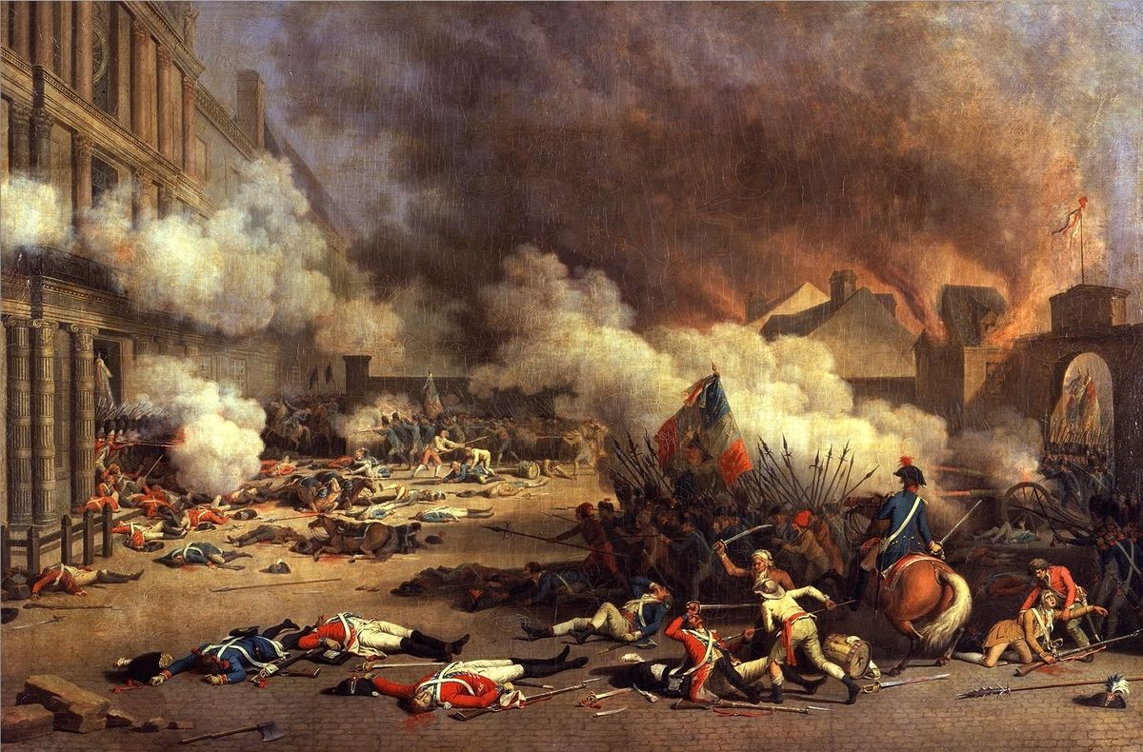

Slide 9
REVOLUTIONS
Big Idea: The French Revolution, beginning in 1789, was a political revolution inspired by Enlightenment ideas and inequity in France.

Slide 10
There were four stages of the French Revolution:
Stage 1: 1789-1791 | Stage 2: 1792-1794 | Stage 3: 1795-1799 | Stage 4: 1799-1815
National Assembly | Radical Revolution | Directory | Age of Napoleon

Slide 11
The French Revolution in a Nutshell (00:00 to 2:13)

Slide 12
BRAINPOP: The French Revolution (4:16)

Slide 13
SQ 6. What was the French Revolution?

Slide 14
SQ 7. What were the social, economic, and political issues that led to the French Revolution?
Big Idea: The French Revolution was caused by economic and social inequity and the abuse of power by absolute monarchs.

Slide 15
Social Issues: The Three Estates
The estates system was the class structure or hierarchy in France before the French Revolution. The same groups that held power during the Middle Ages still had control after the Middle Ages ended.
clergy: people who work for the church like the Pope, bishops, and priests | nobility: wealthy landowners and people with high status in society | commoners: peasants and city-workers

Slide 18
The Three Estates, You Should Hope this Game Will Be Over Soon, 1788

Slide 19
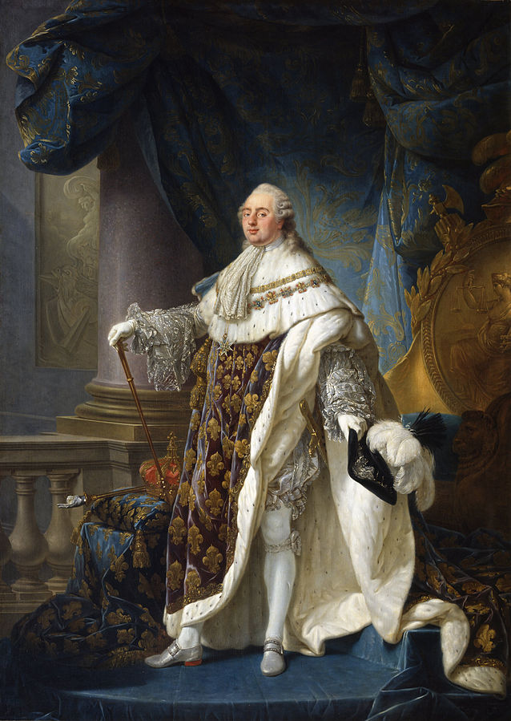
Political Issues: Absolute Monarchy
An absolute
monarchy is a form of government in
which one ruler has supreme authority
without limitation.

Slide 20
Powers of the king.—The King, Louis XVI, was absolute. He ruled by the divine right theory which held that he had received his power to govern from God and was therefore responsible to God alone. He appointed all civil officials and military officers. He made and enforced the laws. He could declare war and make peace. He levied taxes and spent the people’s money as he saw fit. He controlled the expression of thought by a strict censorship of speech and press. By means of lettres de cachet (sealed letters which were really blank warrants for arrest) he could arbitrarily [without reason] imprison anyone without trial for an indefinite period. He lived in his magnificent palace at Versailles, completely oblivious to the rising tide of popular discontent [frustration]. . . .

Slide 21
Economic Issues: Debt and Rising Costs
Debt is money that is owed to someone else. When a country is in debt, it means that they have to pay the money back to whomever it is owed leaving less money for the country to pay for other things.

Slide 22
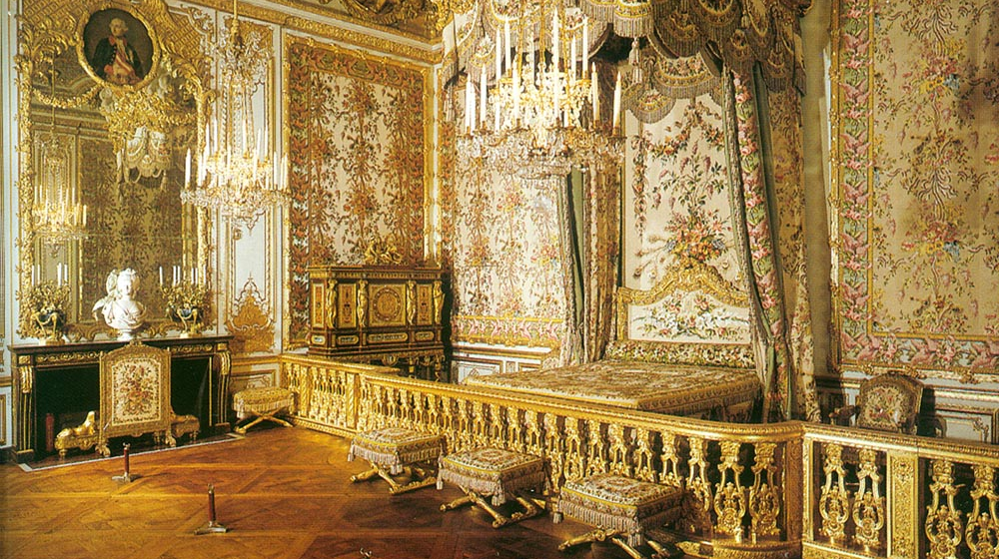
The Palace of Versailles was a royal château [castle] in Versailles and was the center of political power in France from 1682 until 1789. Louis XVI and his wife Marie Antoinette lived in the palace before the French Revolution. They were known for throwing lavish parties.

Slide 23
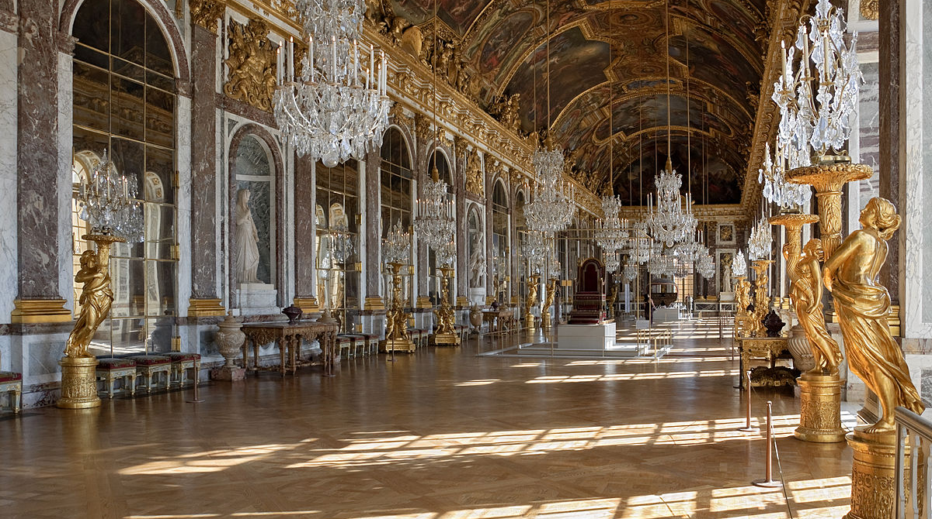
Palace of Versailles​

Slide 24
France’s government was in enormous debt. King Louis XIV (1638-1715), Louis XV (1710-1774), and Louis XVI (1754-1793) added to the debt, borrowing money to finance the following:

Slide 25
The French Revolution – The History Channel (20:00 – 22:15)

Slide 26
SQ 8. During the National Assembly stage of the French Revolution what actions were taken to address issues in France? To what extent did those actions fix those problems?
Big Idea: During the National Assembly stage of the French Revolution, three actions were taken to address issues in France: laws were passed and people attacked the Bastille and the Palace of Versailles.

Slide 27
May-June 1789: The Estates General is Called and the National Assembly Established

Slide 28
The Estates General was a meeting where representatives from the French estates (the clergy, the nobility, and the commoners) gathered. The Estates General had not met since 1614. In May 1789, King Louis XVI called the three estates together to discuss the problems that France faced.

Slide 29
At the Estates General each estate only had one vote. Even though the third estate, or the commoners, had the largest population, they did not receive what they felt was fair representation in the decision-making.

Slide 30
The third estate feared that they would be overruled and outvoted by the first and second estates. Because of this fear, the third estate broke away and formed the National Assembly in June 1789.

Slide 31
When members of the National Assembly got to the chamber where they planned to meet on June 20, 1789, they found the door locked and guarded by soldiers. They thought the king might attack them for forming the National Assembly, so they found a tennis court nearby to meet where they took the Tennis Court Oath.

Slide 32
In the oath, they promised to not disband until they created a new national constitution [a document that describes how a government operates] that would create a government that limited the power of the king and give the people more voice. King Louis XVI attempted to force the National Assembly to disband, however, they refused, so the king had to recognize the National Assembly. Some saw this recognition as a weakening of the king’s power.

Slide 33
July 1789: Storming the Bastille (26:28 to 31:03)

Slide 34
August, 1789: The National Assembly Passes Laws to Change France
August 4, 1789: The Decree Abolishing the Feudal System
A decree is an official order from a government. The Decree Abolishing the Feudal System was passed by the National Assembly on August 4, 1789.

Slide 35
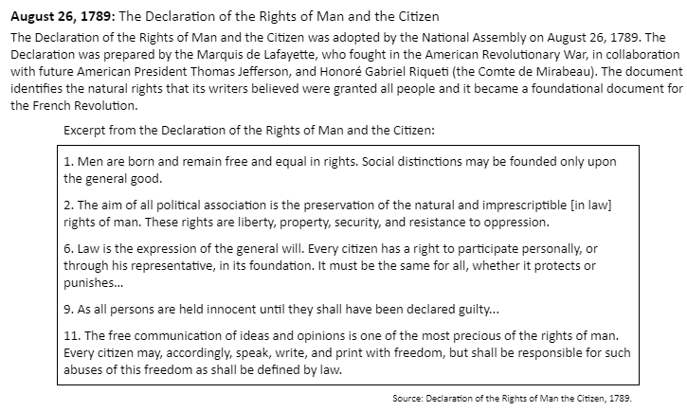

Slide 36
October 1789: Women from Paris marched to the Palace at Versailles, captured Louis XVI and his family, and forced them to come to Paris. (33:49 to 39:45)

Slide 37
September 3, 1791: The Constitution of 1791
The Constitution of 1791 was the first constitution written during the French Revolution.
3. The legislative power is delegated to a National Assembly, composed of temporary representatives freely elected by the people, to be exercised by it, with the sanction [approval] of the King, in the manner hereinafter determined.
4. The government is monarchical; the executive power is delegated to the King, to be exercised, under his authority, by ministers and other responsible agents in the manner hereinafter determined.
5. The judicial power is delegated to judges who are elected at stated times by the people.

Slide 38
SQ 9. During the Radical Revolution stage of the French Revolution what actions were taken to address issues in France? To what extent did those actions fix those problems?
Big Idea: During the Reign of Terror stage of the French Revolution, extremists attempted to address issues in France through violence by executing those that opposed them.

Slide 40
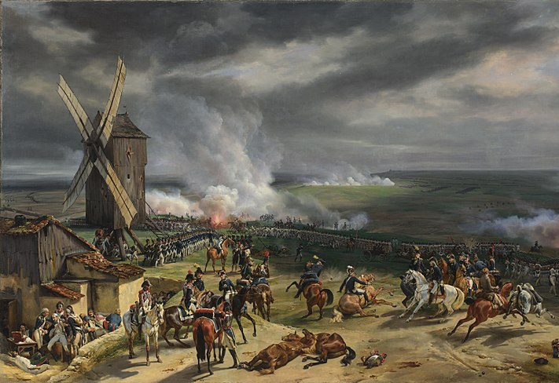
Radical Revolution Stage Timeline: 1792-1794
April 1792: France declares war on Austria, Prussia, Britain, Holland, and Spain

Slide 41
January 1793: Louis XVI is executed (49:32- 59:22)

Slide 42
March 1793: Robespierre leads Committee of Public Safety and the Reign of Terror begins (1:10:13- 1:19:09)

Slide 43
“Robespierre, after having all the French guillotined, beheads the executioner with his own hand.”
Executions During the Reign of Terror

Slide 44
The Committee of Public Safety was set up in 1793 to defend France against internal and external enemies. The original leaders of the Committee of Public Safety were replaced with more radical revolutionaries who were willing to defend the revolution at any cost. One of the most well-known new leaders was Maximilien Robespierre who led the Reign of Terror.

Slide 45
The Reign of Terror was a period from 1793 until 1794 when the Committee of Public Safety suspended rights guaranteed in the new constitution leading to wide-scale repression. The freedom of the press, previously an important aspect of the revolution, was taken away. The influence of the Catholic Church was attacked. Spies were sent throughout the country to find “enemies of the revolution.” During this time, those suspected of being an enemy of the revolution were executed by guillotine.

Slide 46
July 1794: Robespierre is executed and the Reign of Terror ends (1:19:10-1:30:23)

Slide 47
Watch Flocabulary The French Revolution

Slide 48
During the Age of Napoleon stage of the French Revolution what actions were taken to address issues in France? To what extent did those actions fix those problems?

Slide 49
Big Idea: During the Age of Napoleon, Napoleon Bonaparte took control of the government and attempted to address issues in France through order and conquest.

Slide 50
Who was Napoleon Bonaparte (1769-1821)?

Slide 51
WATCH: Egalite for All: Toussaint L'ouverture and the Haitian Revolution
(54:33)

Slide 52
10.02 Quizlet
10.02 Quizlet

Slide 53
COMPLETE: French Revolution Pgs. 64-65
Latin American Revolution Pgs. 65-67

