Slide 1
10.01 Enlightenment, Revolution and Nationalism

Slide 2
Conceptual Understandings:
Enduring Understanding(s): NYS Key Ideas 10.2: ENLIGHTENMENT, REVOLUTION, AND NATIONALISM: The Enlightenment called into question traditional beliefs and inspired widespread political, economic, and social change. This intellectual movement was used to challenge political authorities in Europe and colonial rule in the Americas. These ideals inspired political and social movements. (Standards: 2, 3, 5; Themes: MOV, TCC, GEO, SOC, GOV, CIV) | Essential Question: How do turning points change history? Supporting Questions: 10.2a: According to the Enlightenment thinkers, how should a government rule its people? 10.2b: How did the Enlightenment affect 18th century social reform movements and Enlightened Despots? 10.2c: Was the French Revolution successful? 10.2d: What impact did the French Revolution have on world history?
Knowledge (NYS Conceptual Understandings): Students will know... | Skills (based on the NYS Content Specifications): Students will be able to…
10.2a Enlightenment thinkers developed political philosophies based on natural laws, which included the concepts of social contract, consent of the governed, and the rights of citizens. | Students will examine at least three Enlightenment thinkers, including John Locke, Baron de Montesquieu, and Jean-Jacques Rousseau, and key ideas from their written works.
10.2b Individuals used Enlightenment ideals to challenge traditional beliefs and secure people’s rights in reform movements, such as women’s rights and abolition; some leaders may be considered enlightened despots. | Students will explore the influence of Enlightenment ideals on issues of gender and abolition by examining the ideas of individuals such as Mary Wollstonecraft and William Wilberforce.
 | Students will examine enlightened despots including Catherine the Great

Slide 3
Conceptual Understandings:
Enduring Understanding(s): NYS Key Ideas 10.2: ENLIGHTENMENT, REVOLUTION, AND NATIONALISM: The Enlightenment called into question traditional beliefs and inspired widespread political, economic, and social change. This intellectual movement was used to challenge political authorities in Europe and colonial rule in the Americas. These ideals inspired political and social movements. (Standards: 2, 3, 5; Themes: MOV, TCC, GEO, SOC, GOV, CIV) | Essential Question: How do turning points change history? Supporting Questions: 10.2a: According to the Enlightenment thinkers, how should a government rule its people? 10.2b: How did the Enlightenment affect 18th century social reform movements and Enlightened Despots? 10.2c: Was the French Revolution successful? 10.2d: What impact did the French Revolution have on world history?
Knowledge (NYS Conceptual Understandings): Students will know... | Skills (based on the NYS Content Specifications): Students will be able to…
10.2a Enlightenment thinkers developed political philosophies based on natural laws, which included the concepts of social contract, consent of the governed, and the rights of citizens. | Students will examine at least three Enlightenment thinkers, including John Locke, Baron de Montesquieu, and Jean-Jacques Rousseau, and key ideas from their written works.
10.2b Individuals used Enlightenment ideals to challenge traditional beliefs and secure people’s rights in reform movements, such as women’s rights and abolition; some leaders may be considered enlightened despots. | Students will explore the influence of Enlightenment ideals on issues of gender and abolition by examining the ideas of individuals such as Mary Wollstonecraft and William Wilberforce.
 | Students will examine enlightened despots including Catherine the Great

Slide 4
Unit Essential Questions:
How did new ideas spark change and conflict in the late 18th and throughout the 19th centuries?
How do turning points change history?

Slide 5
Unit Description
The Enlightenment called into question traditional beliefs and inspired widespread political, economic, and social change. This intellectual movement was used to challenge political authorities in Europe and colonial rule in the Americas. These ideals inspired political and social movements.

Slide 6
Unit Activities and Assignments
VOCABULARY OPENER
CONTEXTUALIZE AND CONNECT CAUSE AND EFFECT – EXPLAIN the historical circumstances that led to Absolute Monarchs in Europe in a CLAIM PARAGRAPH
MASTERING THE GRADE 10 GLOBAL HISTORY CURRICULUM - Chapter 6 -pgs. 56 – 79
STUDY CARDS
CLOSE READ ACTIVITY (Mary Wollstonecraft)
Castle Learning 10.02
CONCEPT MAPS
The Enlightenment
French Revolution
Haitain Revolution
South American Independence Movements
Mexican War for Independence
Unification of Germany
Unification of Italy

Slide 7
BOOK PAGES
Enlightenment – 56-64
French Revolution – 64-65
Latin American Revolution 65-67
Unification of Italy – 67-68
Unification of Germany 68-70
Study Cards/Review 71-79

Slide 8
Day 1:
Complete SQ1: What was the political and cultural situation in Europe ca. 1750?
PASS OUT VOCABULARY OPENER
CHROLOLOGICAL THINKING AND GRAPHIC CONTEXT – The World in 1750 Cause and Effect Chain Activity

Slide 9
What was the political and cultural situation in Europe ca. 1750?
Examine events from the Middle Ages to the mid-1700s from multiple perspectives.

Slide 10
PICK-A-PARTNER
COMPLETE: REVIEW PACKET: THE WORLD IN1750
With a partner – complete the review pack - DUE before you leave ;-)

Slide 11
Get in groups of 5

Slide 12
Read the prompt and as a group, predict possible answers by brainstorming. Jot down your ideas under the prompt.

Slide 14
Feudalism Established in Europe

Slide 15
Catholic Church and Later Protestant Churches Gain Power in Europe

Slide 18
TOGETHER: Write a Cause and Effect paragraph to answer the following prompt

Slide 19
The Enlightenment
Big Idea: The Enlightenment was a period of time (mid-1600s to the late 1700s) in Western Europe when philosophers challenged the power of Catholic Church and absolute monarchs. The Enlightenment was caused by new ideas formed during the scientific revolution and frustration with leaders who abused their power. The ideas developed during the Enlightenment were able to spread because of increased literacy and urbanization.

Slide 20
In Europe, in the mid-1600s to late 1700s scholars inspired by the Scientific Revolution started to ask questions like,
“What is the purpose of government?,”
“What is the best way for a government to rule its people?,”
“Are people born with rights? If so, should they be protected by a government?”
The philosophers writing about these questions were part of the Enlightenment.

Slide 21
Heroes of the Enlightenment, Episode 2 (0:00-1:22)

Slide 22
1. Power of Absolute Monarchs

Slide 23
In the 1500s, 1600s and 1700s, some monarchs in Europe became very wealthy. As a result, they were able to pay for large and powerful armies and expand their land and power. These kings and queens are known as Absolute Monarchs. Most of the countries in Europe were ruled by absolute monarchs in the 17th and 18th centuries. Louis XIV of France and Peter the Great of Russia were examples of absolute monarchs.
Many absolute monarchs consolidated and maintained their power by punishing those who opposed them and questioned their right to rule.

Slide 24
2. Protestant Reformation and Scientific Revolution Influence

Slide 25
Martin Luther’s actions in the Protestant Reformation challenged the Catholic Church’s hold on power by translating the Bible into common languages and encouraging people to read it for themselves instead of having priests translate it for them.
Isaac Newton and other scientists used observation and reason to explain the true nature of the world which often proved the Catholic Church’s claims wrong.

Slide 26
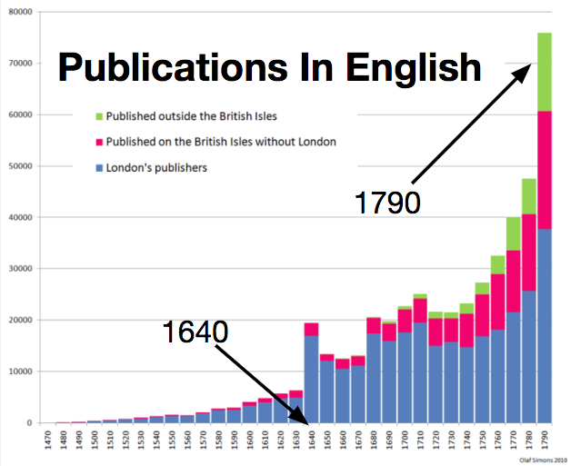
3. Increased Book Production and Literacy

Slide 27
Johannes Gutenberg invented his printing press around 1440. That invention made it easier and less expensive to produce books. It was very important in spreading Martin Luther’s ideas during the Protestant Reformation.
During the Enlightenment, book production increased even more and literacy rates, the percentage of people who are able to read, also increased.

Slide 28
4. Urbanization, Salons, and Coffeehouses

Slide 29
During the 1700s, the process of urbanization (people moving to cities and the growth of those cities) increased in Europe. As more people moved to cities they found places to socialize and discuss ideas.
Coffee was a newly popular drink in Europe and intellectuals from the upper and middle classes like the philosophes came to coffee houses to drink it and discuss politics and religion.
Upper class philosophers also exchanged ideas in salons, gatherings, usually at someone’s home where the guests came to listen to readings and discuss a specific topic.

Slide 30
SQ 3. What points of view did Enlightenment Thinkers have about government?

Slide 31
Big Idea: Enlightenment thinkers had different points of view about how the government should work. They expressed these points of view in books where they tried to persuade readers to change how government works.

Slide 32
BOOK PAGES
Enlightenment – 56-64
French Revolution – 64-65
Latin American Revolution 65-67
Unification of Italy – 67-68
Unification of Germany 68-70
Study Cards/Review 71-79

Slide 33
PASS OUT GRAPHIC ORGANIZER

Slide 34
Location: | England
Famous Writing: | Two Treatises of Government, 1690
Most Well-Known Ideas: | Government should protect people’s Natural Rights (life, liberty, and property) Government should be based on the Consent of the Governed. This means that the people (the governed) should give their permission (consent) to the government, usually through voting.
John Locke (1632-1704)

Slide 35
John Locke Video Biography from CloudBiography

Slide 36
Excerpt 1: Two Treatises of Government 1690 by John Locke
If man in the state of nature is free, if he is absolute lord of his own person and possessions [things that he owns], why will he give up his freedom? Why will he put himself under the control of any person or institution [an organization created for a religious, educational, social, or political purpose]?

Slide 37
Excerpt 1: Two Treatises of Government 1690 by John Locke
The obvious answer is that rights in the state of nature are constantly exposed to the attack of others. Since every man is equal and since most men do not concern themselves with equity and justice, the enjoyment of rights in the state of nature is unsafe and insecure. Hence each man joins in society with others to preserve his life, liberty, and property.

Slide 38
Excerpt 2: Two Treatises of Government 1690 by John Locke
...as far as we have any light from history, we have reason to conclude, that all peaceful beginnings of government have been laid in the consent [permission] of the people.

Slide 39
Excerpt 3: Two Treatises of Government 1690 by John Locke
[When] the legislature shall . . . grasp [for] themselves, or put into the hands of any other, an absolute power over their lives, liberties, and estates of the people, . . . they forfeit [give up] the power the people had put into their hands for quite contrary [opposite] ends, and it [passes] to the people, who have a right to resume their original liberty. . . .

Slide 40
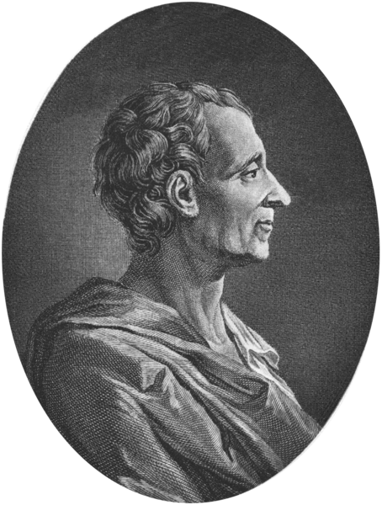
Location: | France
Most Famous Writing: | The Spirit of Laws, 1748
Most Well-Known Idea: | Separation of Powers- there should be three branches of government- one that makes laws, one that enforces laws, and one that interprets laws
Baron de Montesquieu (1689-1755)

Slide 41
Essential Enlightenment: Montesquieu

Slide 42
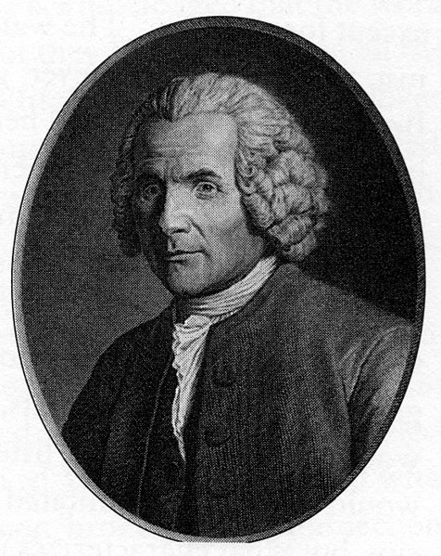
Location: | Switzerland/France
Most Famous Writing: | The Social Contract, 1762
Most Well-Known Idea: | Social Contract Theory
Jean-Jacques Rousseau (1712-1778)

Slide 43
The Spirit of Laws, 1748 by Baron de Montesquieu
Political liberty is to be found only in moderate governments; and even in these it is not always found. It is there only when there is no abuse of power: but constant experience shows us that every man invested with power is apt to abuse it, and to carry his authority as far as it will go. To prevent this abuse, it is necessary, from the very nature of things, that power should be a check to power...In order to have this liberty, it is requisite [required] the government be so constituted [created] as one man need not be afraid of another. When the legislative and executive powers are united in the same person, or in the same body of magistrates [government employees], there can be no liberty. . . . Again, there is no liberty if the judiciary power be not separated from the legislative and executive…

Slide 44
Jean Jacques Rousseau Video Biography from CloudBiography

Slide 45
Jean-Jacques Rousseau was born in Geneva, Switzerland where he wrote his most famous book, The Social Contract. In the book, Rousseau argues that as members of a society we enter an agreement, the social contract, in which we promise to follow the “general will” of the members of the society as expressed by the laws made by the government. In exchange, we receive the liberty to do what we want as long as we do not break those laws.

Slide 46
I...regard the establishment of the political body as a real contract between the people and the chiefs chosen by them: a contract by which both parties bind themselves to observe the laws therein expressed, which form the ties of their union.
The Social Contract, 1762 by Jean-Jacques Rousseau

Slide 47
From whatever side we approach our principle [belief], we reach the same conclusion, that the social compact [contract] sets up among the citizens an equality of such a kind, that they all bind themselves to observe the same conditions and should therefore all enjoy the same rights.
The Social Contract, 1762 by Jean-Jacques Rousseau

Slide 49
SQ 4. What effect did the Enlightenment have on social reform movements and monarchs in the 18th century?

Slide 50
Big Idea: Audience impacts the way we deliver our points of view. Leaders of social reform movements in the 18th century used Enlightenment language to communicate their discontent and hope for the future to an audience familiar with Enlightenment ideas.

Slide 51
The Abolition Movement Starts in England
Supporters of the Slave Trade
Several groups who found the practice of slavery immoral petitioned [asked] the British government to stop trading slaves in the 1700s, but It was the Society for the Abolition of the Slave Trade, organized in May 1787. Eventually, in 1807 they were successful in getting Parliament to pass a law outlawing slavery and the slave trade in England and all of the British colonies.

Slide 52
The Roots of Feminism and Women’s Rights Movements
Women
Using Enlightenment ideas, some women, including Mary Wollstonecraft, argued for more equal rights for men and women. Mary Wollstonecraft (April 27, 1759 – September 10, 1797) was a British intellectual, writer, philosopher, and early feminist.

Slide 53
SQ 5. To what extent did Mary Wollstonecraft challenge ideas about the rights of women in 18th century Europe?

Slide 54
COMPLETE MARY WOLLONSTONECRAFT CLOSE READ

Slide 55
Enlightenment Pgs. 56-64

Slide 56
10.02 Quizlet
10.02 Quizlet

