Slide 1
Notes:
Hey all you cool cats & kittens thank you so much for downloading this product! I hope your class loves the Australia Zoo! It will make you reminisce on the Crocodile Hunter days!

Slide 2
There will be trees!
We will need to go on a plane!
There will be cats!
Notes:
You may want to change to clues based on your grade level! I left them pretty vague to not spoil it!

Slide 4
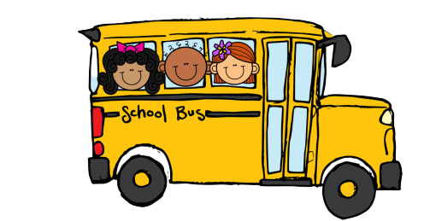

Slide 5
Click to view!

Slide 9
Robert Irwin's Australia Zoo Tour

Slide 10
Notes:
Call on students individually to share their favorite part OR have them draw their favorite animal after you’re done with your meeting.

